Slide 1
MGS 723: Geodynamics
Class 4: Elasticity I

Slide 2
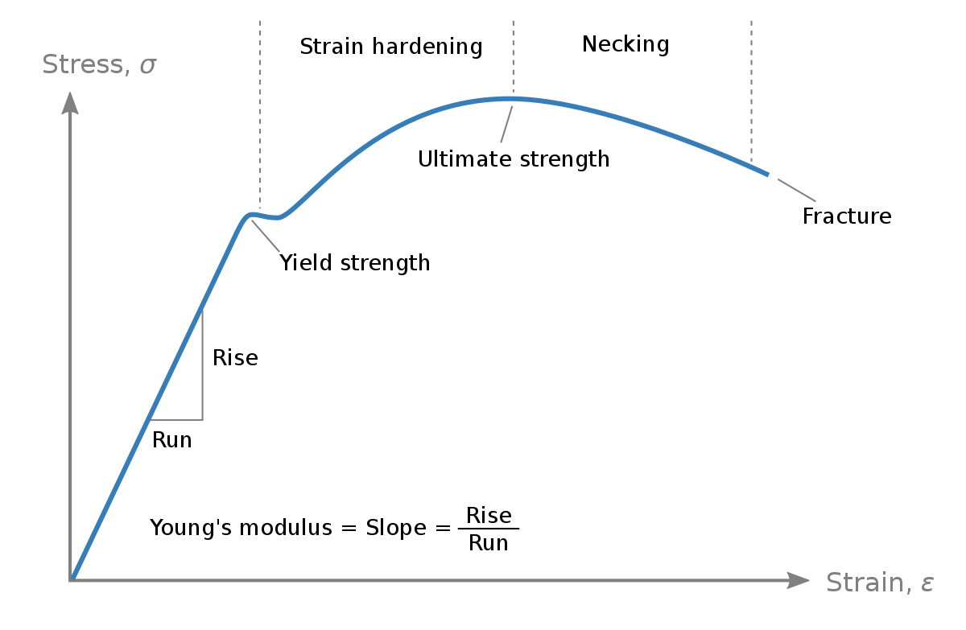
Stress produces deformation
Forces
Deformation
The nature of the curve – i.e., the link between forces and deformation – depends on the material strength/properties

Slide 3
Stress produces deformation
Forces
Deformation
The nature of the curve – i.e., the link between forces and deformation – depends on the material strength/properties
“rheology”

Slide 4
Rheology of crust and mantle rocks
Kinematics (measurable deformation) and dynamics (forces) are linked:

Slide 5
Rheology of crust and mantle rocks
Kinematics (measurable deformation) and dynamics (forces) are linked:
Rheology concerns itself with how materials behave.
Tries to establish relevant constitutive laws which link the dynamic properties (stresses) to the kinematic ones (strains, strain rates, strain histories,…).

Slide 6
Rheology of crust and mantle rocks
Kinematics (measurable deformation) and dynamics (forces) are linked:
Rheology concerns itself with how materials behave.
Tries to establish relevant constitutive laws which link the dynamic properties (stresses) to the kinematic ones (strains, strain rates, strain histories,…).
Some complexities:
For a given material, often many different rheological behaviors, over different time/length scales. E.g., rocks: elastic/brittle during earthquakes, viscous during convection.
Links depend on many parameters, which are highly variable (and often poorly constrained) on Earth. E.g., water content, temperature.
Much of our knowledge from lab experiments but cannot access the range of conditions of Earth deformation (e.g., loading over Myr timescales).

Slide 7
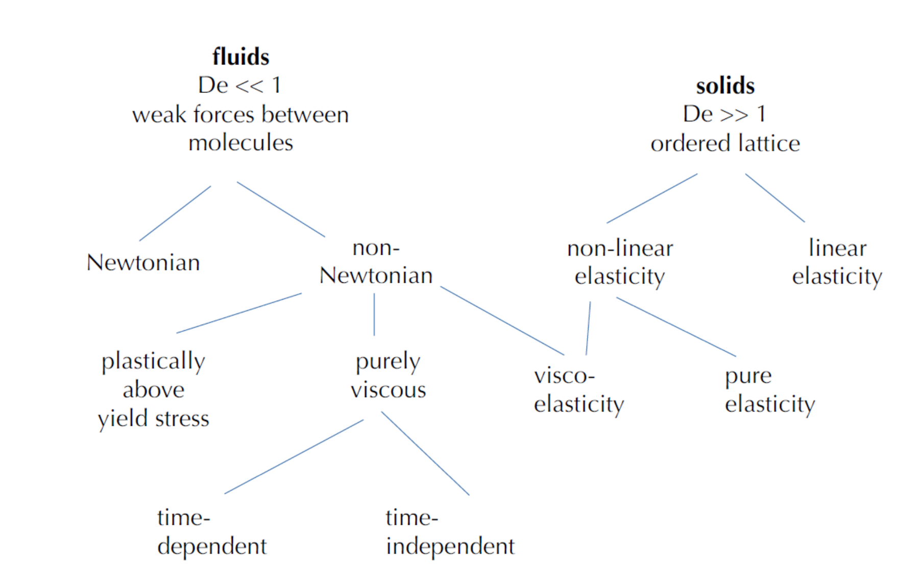
Rheology of crust and mantle rocks
Becker and Faccenna
Notes:
The Deborah number is the ratio of fundamentally different characteristic times. Formally, the Deborah number is defined as the ratio of the time it takes for a material to adjust to applied stresses or deformations, and the characteristic time scale of an experiment (or a computer simulation) probing the response of the material:

Slide 8
Rheology of crust and mantle rocks
Deborah # = t_{C} / t_{P} (how fluid-like a material is)
Notes:
The Deborah number is the ratio of fundamentally different characteristic times. Formally, the Deborah number is defined as the ratio of the time it takes for a material to adjust to applied stresses or deformations, and the characteristic time scale of an experiment (or a computer simulation) probing the response of the material:

Slide 9
Rheology of crust and mantle rocks
Notes:
The Deborah number is the ratio of fundamentally different characteristic times. Formally, the Deborah number is defined as the ratio of the time it takes for a material to adjust to applied stresses or deformations, and the characteristic time scale of an experiment (or a computer simulation) probing the response of the material:

Slide 10


Rheology of crust and mantle rocks
ELASTICITY
$$F=k dx$$

Slide 11
Rheology of crust and mantle rocks
ELASTICITY
$$F=k dx$$
Hooke’s law
Linear elastic behavior.
That is: Force (stress) is linearly proportional to deformation (strain)

Slide 12

ELASTICITY in geodynamics?

Slide 13
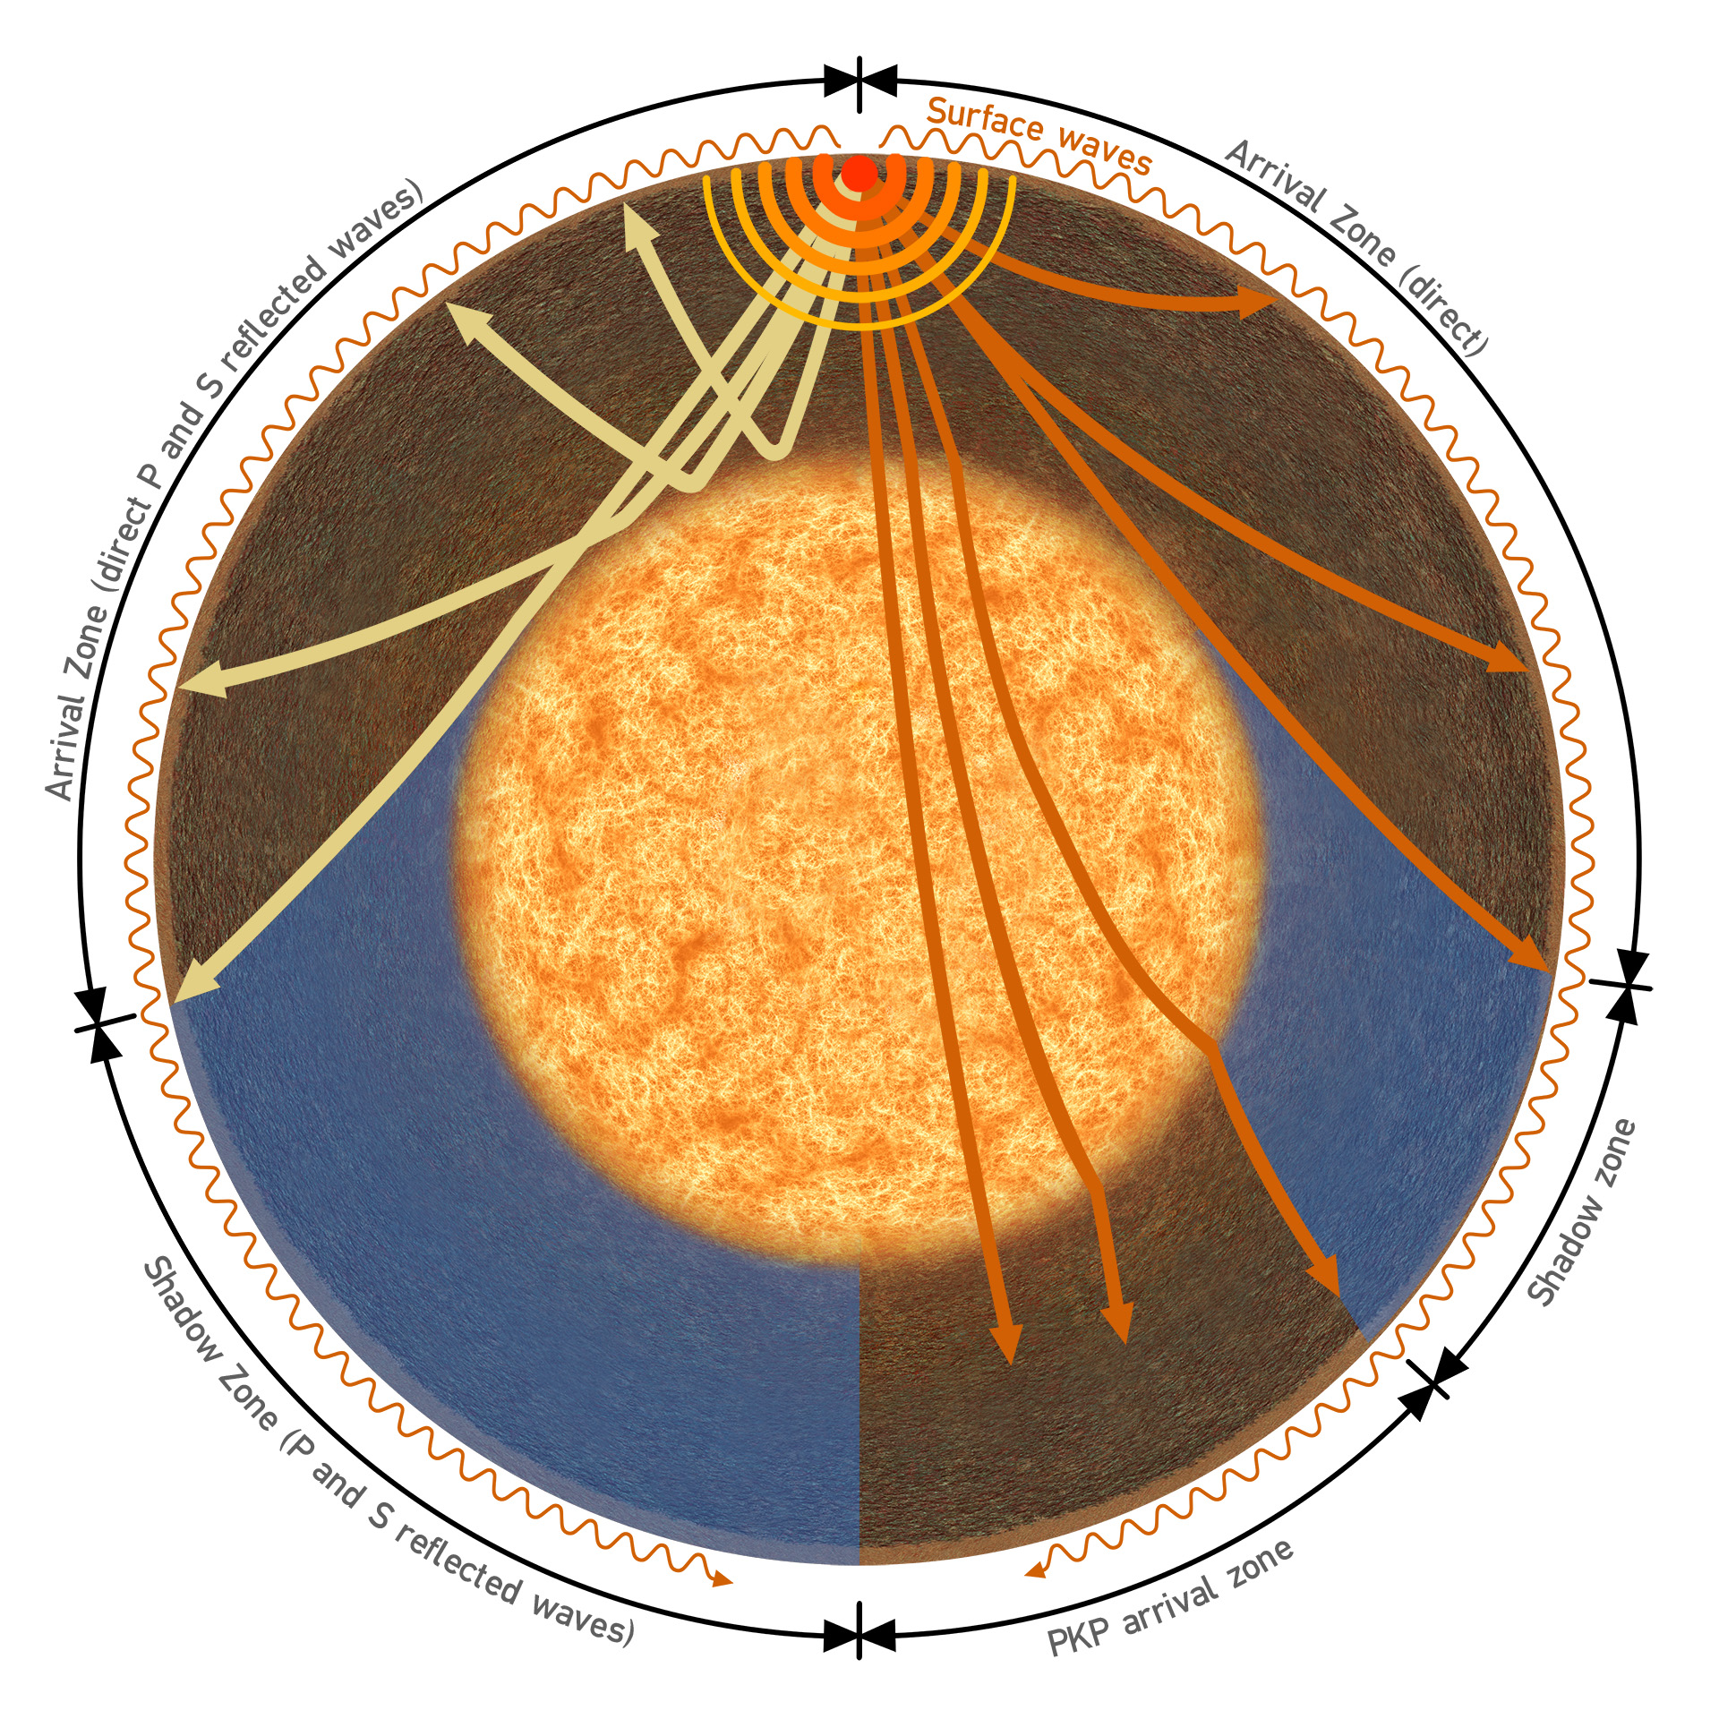
ELASTICITY in geodynamics?
seismic wave propagation

Slide 14
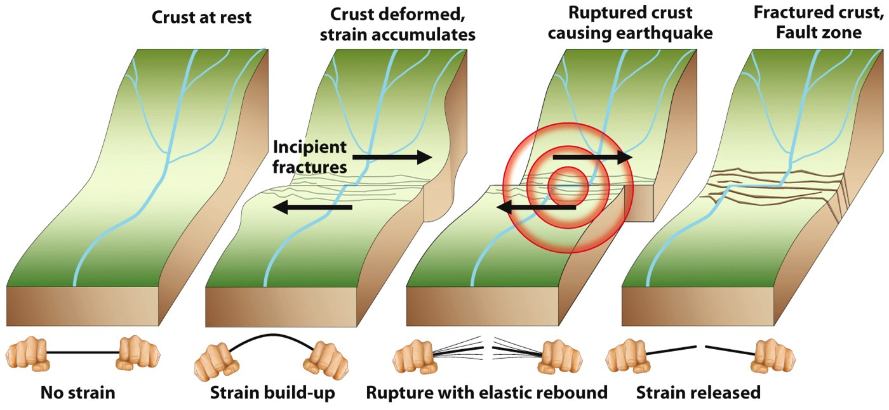
ELASTICITY in geodynamics?
seismic wave propagation
Earthquake and
volcano deformation

Slide 15
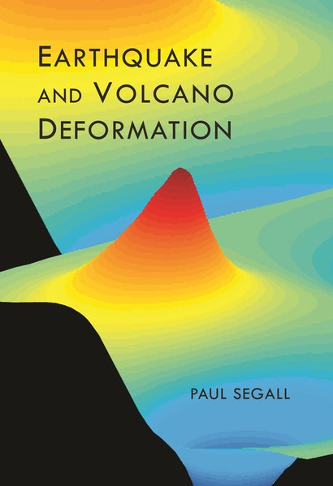
ELASTICITY in geodynamics?
seismic wave propagation
Earthquake and
volcano deformation

Slide 16
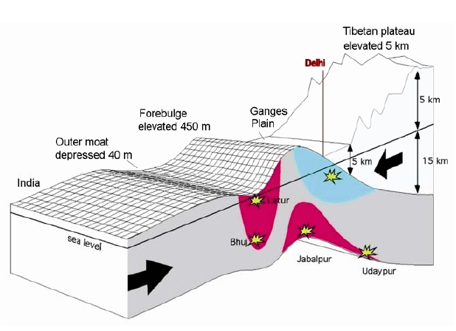
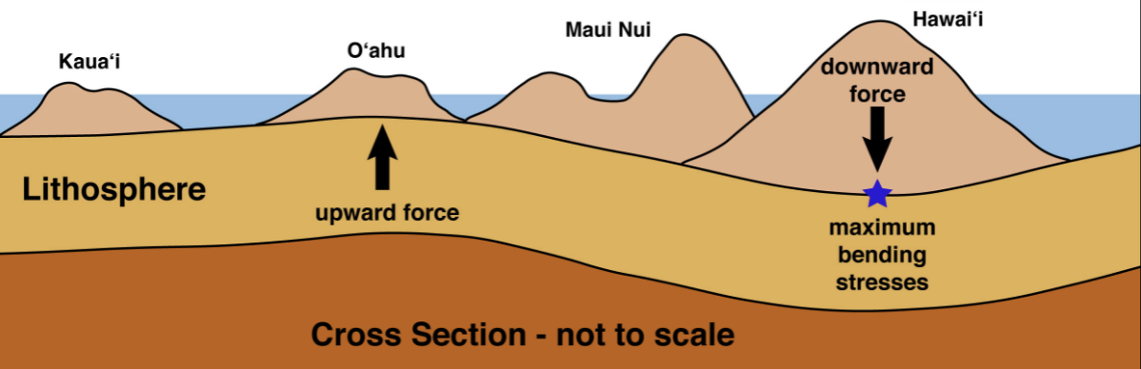
ELASTICITY in geodynamics?
seismic wave propagation
Earthquake and
volcano deformation
plate flexure

Slide 17
ELASTICITY in geodynamics?
seismic wave propagation
Earthquake and
volcano deformation
plate flexure

Slide 18
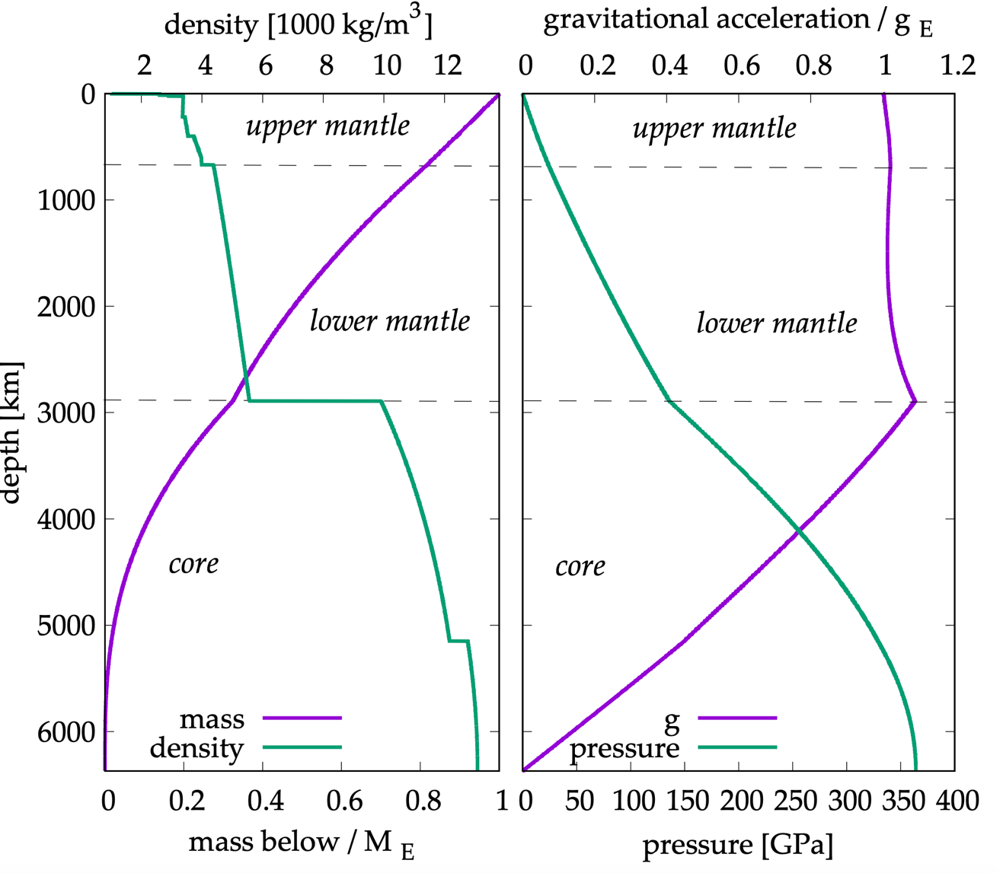
ELASTICITY in geodynamics?
seismic wave propagation
PREM (Dziewonski and Anderson, 1981)
plate flexure

Slide 19

To the stylus…
To: understand linear elasticity and consider: uniaxial and plane stress situations.

Slide 20
Take homes:
Rheology (and constitutive laws) links forces (stress) and deformation.
One of the simplest and most relevant to Solid Earth Science: Elasticity
Can describe a linear, isotropic solid with two elastic moduli (e.g., Young’s mod and Poisson’s ratio).
Uniaxial stress: easiest way to determine a rock sample’s elastic parameters.
Plane stress: moving closer towards a crustal/lithospheric situation…

Slide 21
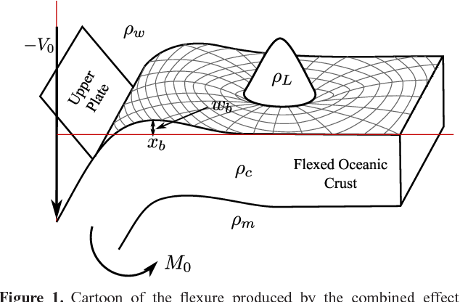
Next session: Plate bending/flexure

